Slide 1

De-anonymisation of Cryptocurrency Transactions
20
24
Mini Project
We will explore Mini Project overview in this ppt.
Niranjan Ambi
Tirth Katkar
Sakshi Patil
Srushti Shete
20
24

Slide 2
Problem statement
20
24
Mini Project
Background: Cryptocurrencies enable illegal activities due to pseudonymity.
Problem: Difficult to monitor illicit activities like fraud and money laundering.
Objective: De-anonymize transactions to track illegal activities.
Approach: Use data analysis, graph theory, and machine learning to link blockchain addresses to real-world entities.
Outcome: Improve detection of illicit activities in the crypto space.
20
24

Slide 3
Objectives
1 | Analyze Transaction Data to Identify Suspicious Addresses
2 | Detect Anomalous Transaction Patterns
3 | Cluster Addresses Based on Behavioral Characteristics
4 | Provide Risk Assessment and Visualization of Potential Fraudulent Activities
5 | Generate Detailed Analysis Reports for Further Investigation
6 | Optimize the system to handle large-scale Bitcoin transaction datasets

Slide 4
RESEARCH PAPER
Regulating Blockchain, DLT and Smart Contracts |  | LITERATURE REVIEW
AUTHORS | METHODOLOGY | This paper discusses existing regulatory frameworks for cryptocurrencies and DLT, highlighting their focus on financial aspects and lack of technology assurance requirements.
Joshua Ellul Jonathan Galea Max Ganado Stephen McCarthy Gordon J. Pace | The paper proposes a "world-first technology regulatory framework" for blockchain, DLT, and smart contracts.

Slide 5
RESEARCH PAPER
Detection of Illegal Transactions of Cryptocurrency Based on Mutual Information. |  | LITERATURE REVIEW
AUTHORS | METHODOLOGY | The paper reviews methods for detecting illegal cryptocurrency activities, focusing on data imbalance and graph neural networks. It also covers self-supervised learning techniques for graphs, like auto-encoders and contrastive learning, and discusses strategies to address data imbalance, such as oversampling, undersampling, and new loss functions.
Kewei Zhao Guixin Dong Dong Bian | The paper focuses on developing a self-supervised graph neural network model to detect illegal cryptocurrency transactions.

Slide 6
RESEARCH PAPER
CRYPTOCURRENCY IN THE SYSTEM OF MONEY LAUNDERING |  | LITERATURE REVIEW
AUTHORS | METHODOLOGY | The review covers research on cryptocurrency and illegal activities, the historical and economic context of money and virtual currencies, and legal regulations, citing sources like the European Central Bank and National Bank of Ukraine.
Valeriia Dyntu, National University “Odessa Law Academy”, Ukraine. Oleh Dykyi, National University “Odessa Law Academy”, Ukraine. | The paper employs several methodologies, including historical analysis tracing cryptocurrency's evolution from Friedrich August von Hayek's ideas, case study analysis of criminal cases involving cryptocurrency money laundering, and comparative analysis contrasting global perspectives and regulations, with a focus on Ukraine.

Slide 7
RESEARCH PAPER
Blockchain Forensics: A Modern Approach to Investigating Cybercrime in the Age of Decentralisation |  | LITERATURE REVIEW
AUTHORS | METHODOLOGY | The paper cites a range of sources on topics such as blockchain forensics from CipherBlade, cryptocurrency thefts from news outlets like The Washington Post, DeFi regulation insights from CoinDesk, and AML regulations from sources like NotaBene and The Law Society.
Saminu Salisu, Bilic, London, United Kingdom. Velitchko Filipov, TU Wien, Vienna, Austria. Barry Pene, Bilic, London, United Kingdom. | The paper outlines a framework for investigating blockchain financial crimes, involving tracing transaction origins, analyzing patterns, identifying fund recipients, and using tools like Bitquery for tracking.

Slide 8
RESEARCH PAPER
The next phase of identifying illicit activity in Bitcoin |  | LITERATURE REVIEW
AUTHORS | METHODOLOGY | The paper offers a structured literature review covering techniques for Bitcoin deanonymization, methods of cryptocurrency money laundering, privacy-enhancing technologies, applications of machine learning and deep learning for detecting illicit activities, and law enforcement needs for digital forensics.
Jack Nicholls Aditya Kuppa Nhien-An Le-Khac | The paper uses a "systematization of knowledge" (SoK) approach to review Bitcoin transaction obfuscation, analyze heuristics for deanonymization, discuss improvements via machine learning, and propose future research on detecting illicit activity.

Slide 9
KEY TECHNOLOGIES
KEY FEATURES
1.Python (Pandas, NumPy, scikit-learn, NetworkX) 2.Machine Learning: Isolation Forest, K-MeansGraph 3.Analysis & Visualization: Matplotlib, Seaborn
1.Multi-Layered Approach: i) Data Preprocessing ii) Feature Engineering iii) Anomaly Detection iv) Risk Assessment v) Network Analysis vi) Behavioral Clustering 2. Machine Learning Techniques: i) Isolation Forest ii) K-Means Clustering 3. Graph Analytics: Constructs a network graph
KEY METRICS ANALYSED
1. Transaction Volume & Frequency
2. Deposit-Withdraw Ratios
3. Time-Based Features: Activity periods, transaction intervals
4. Network Metrics: Degree centrality, clustering coefficient

Slide 10
OUTPUT
1. Fraud Detection Insights: Identifies high-risk addresses
Generates detailed behavioral patterns for each cluster.
2. Advanced Visualizations: Risk score distributions
Network graphs of suspicious addresses
Transaction patterns over time.
3. Comprehensive Report: Provides actionable intelligence and recommendations for fraud monitoring.

Slide 11
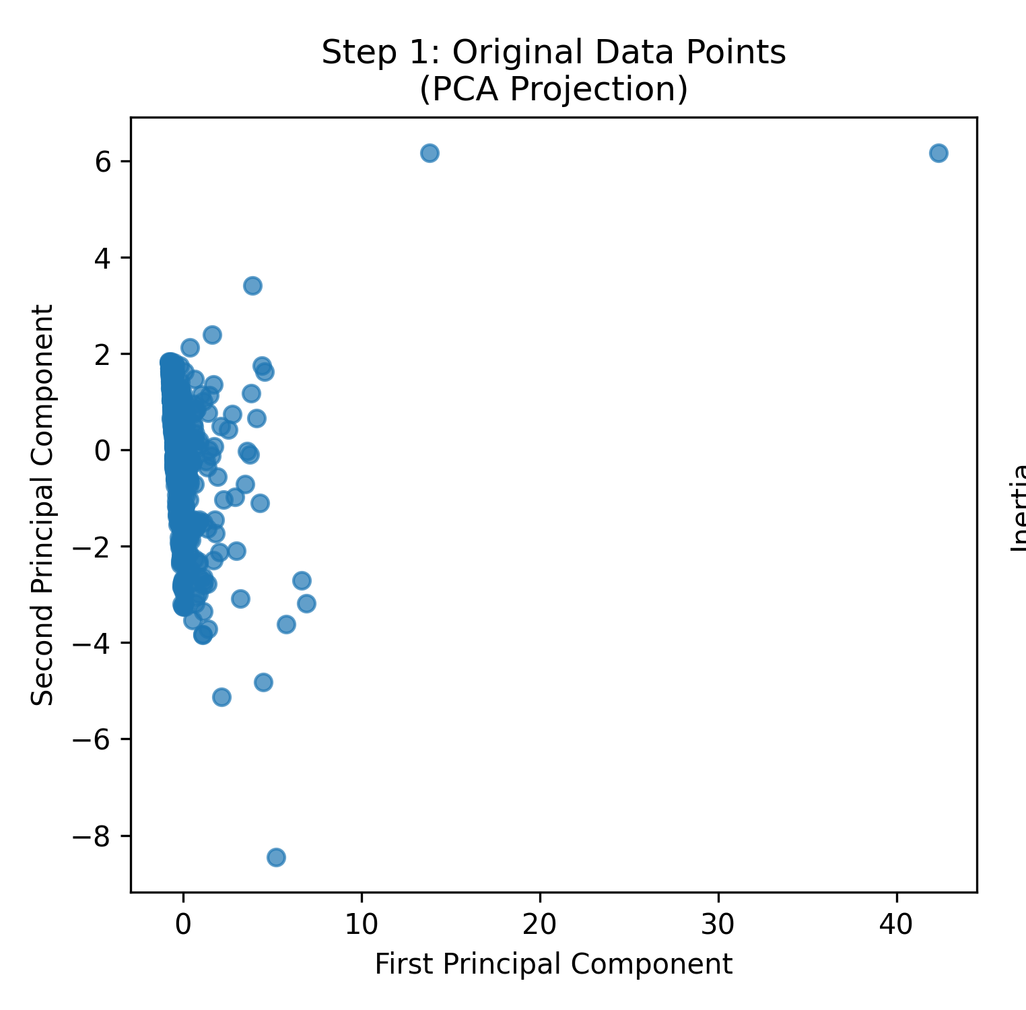
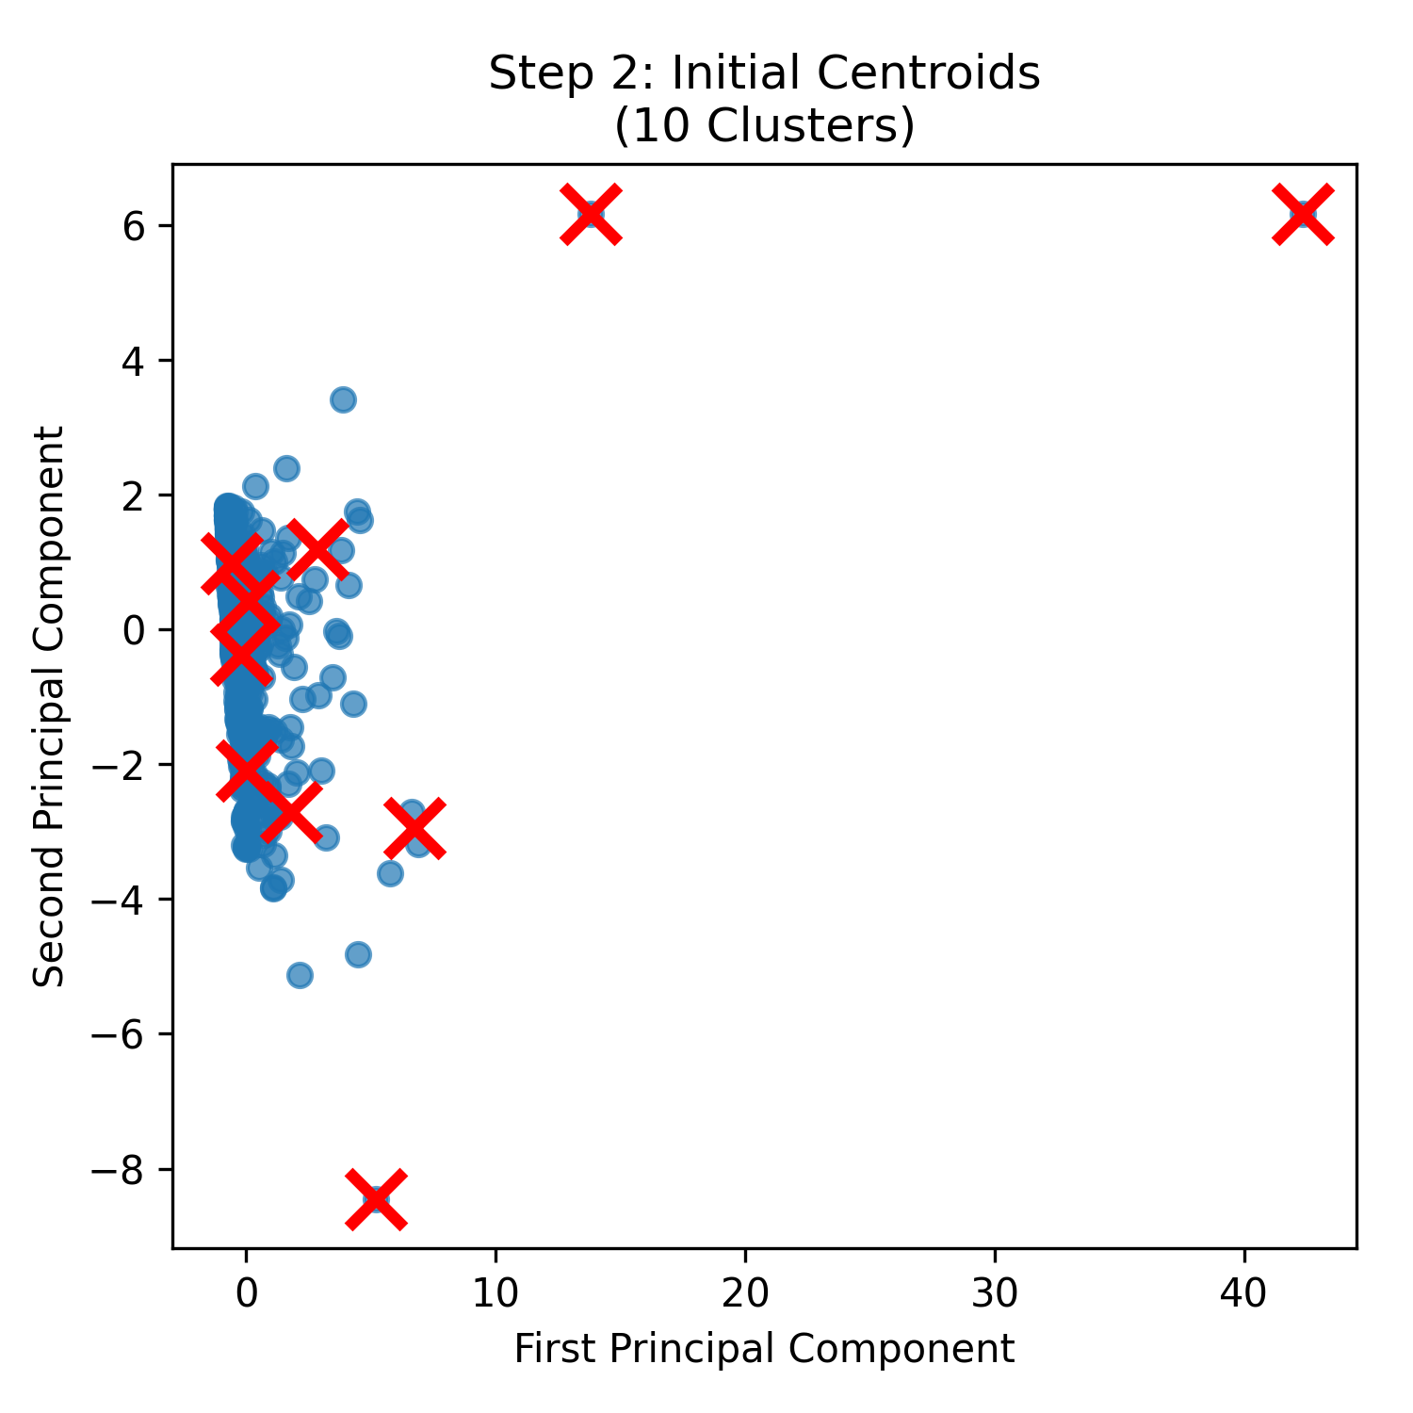
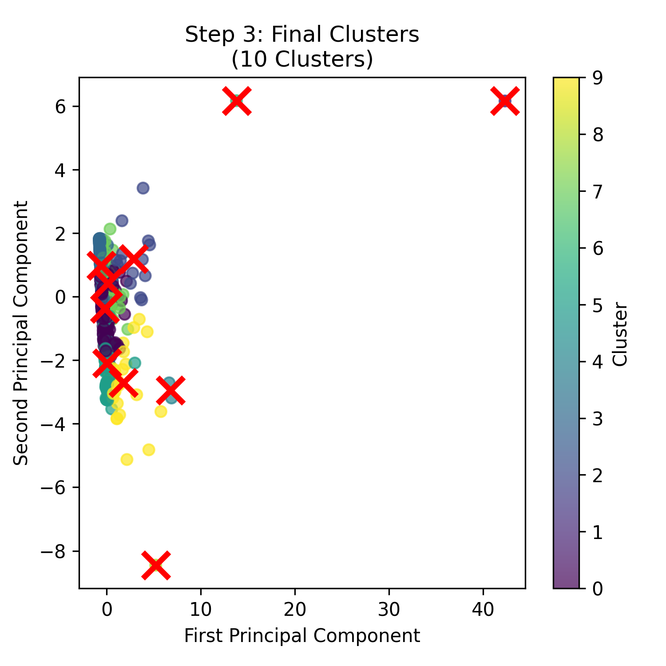
K-Means Visualization
Risk Score Distribution
Addresses per cluster
Transaction time distribution

Slide 12
FUTURE SCOPE
Heuristic Limitations: Existing rule-based methods are becoming less effective as users adopt advanced privacy techniques, and attackers learn to bypass these heuristics.
Need for Labelled Data: The advancement of AI and machine learning models is hindered by a lack of labelled data. Increased availability of such data could drive progress in this field.
Combining AI with Heuristics: Integrating probabilistic models, machine learning, and deep learning with existing heuristics holds promise for more accurate illicit activity detection.
Transaction Topology Analysis: New methods for analyzing transaction networks could reveal connections between malicious actors and larger criminal networks.
Data Imbalance:With most transactions being legitimate, addressing data imbalance through techniques like oversampling, undersampling, and novel loss functions is crucial.
Evolving Cybercrime: As criminal methods evolve, continuous innovation in blockchain analytics, particularly in anomaly detection and money laundering patterns, is essential.

Slide 13
Conclusion
20
24
Mini Project
In conclusion, implementing a project to identify illicit cryptocurrency activity involves integrating advanced heuristics with machine learning and deep learning models, addressing data imbalance, and analyzing transaction topologies. Incorporating privacy-enhancing tools further strengthens the system. This technology can also be adapted for UPI (Unified Payments Interface) transactions, where similar techniques can detect fraudulent activities, analyze transaction patterns, and enhance security measures. By leveraging these approaches, you can create robust systems to safeguard both cryptocurrency and UPI transactions from illicit activities, ensuring a more secure financial environment.
20
24

